Slide 1
Adult educators construct themselves and their learners
in relation to program requirements (Purcell-Gate, 1997; Quigley, 2006)
externally imposed, documentary assessments (Foucault, 1979)
internally constructed, discursive assessments of learners’ identities, processes and progress (Hunsinger, 2005)

Slide 2
Evaluative, disciplinary structures required by the state (Foucault, 1979; Giddens, 1984) modulate the educators’ and learners’ agency. These make some aspects of participation in literacy programs visible, they hide others, particularly stripping dimensions of context, subjectivity and intersectionality (McCall, 2005).

Slide 3
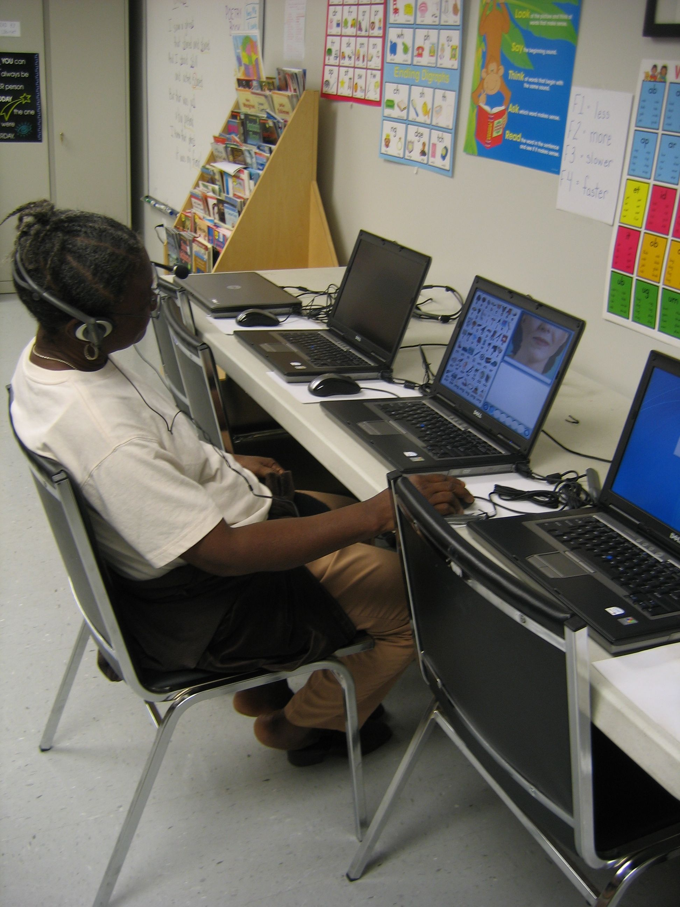
Gendered human action in relation to larger social structures:
Enduring selves
Situated selves
Endangered selves (G. & S. Spindler)
Imagined selves (D. Holland)
Notes:
Many ways in which we may understand human action, agency in relation to the larger social structure. When that structure has a patriarchal base, as it does in the US, and certainly in the Appalachian region, we must address gender to understand self, action and agency

Slide 4
Enduring self
Deep self embedded in family, community and place
Build upon funds of knowledge that the adult learner brings to the classroom.
Curriculum and instruction that attend to what adults already know and care to know in support of engaged learning.

Slide 5
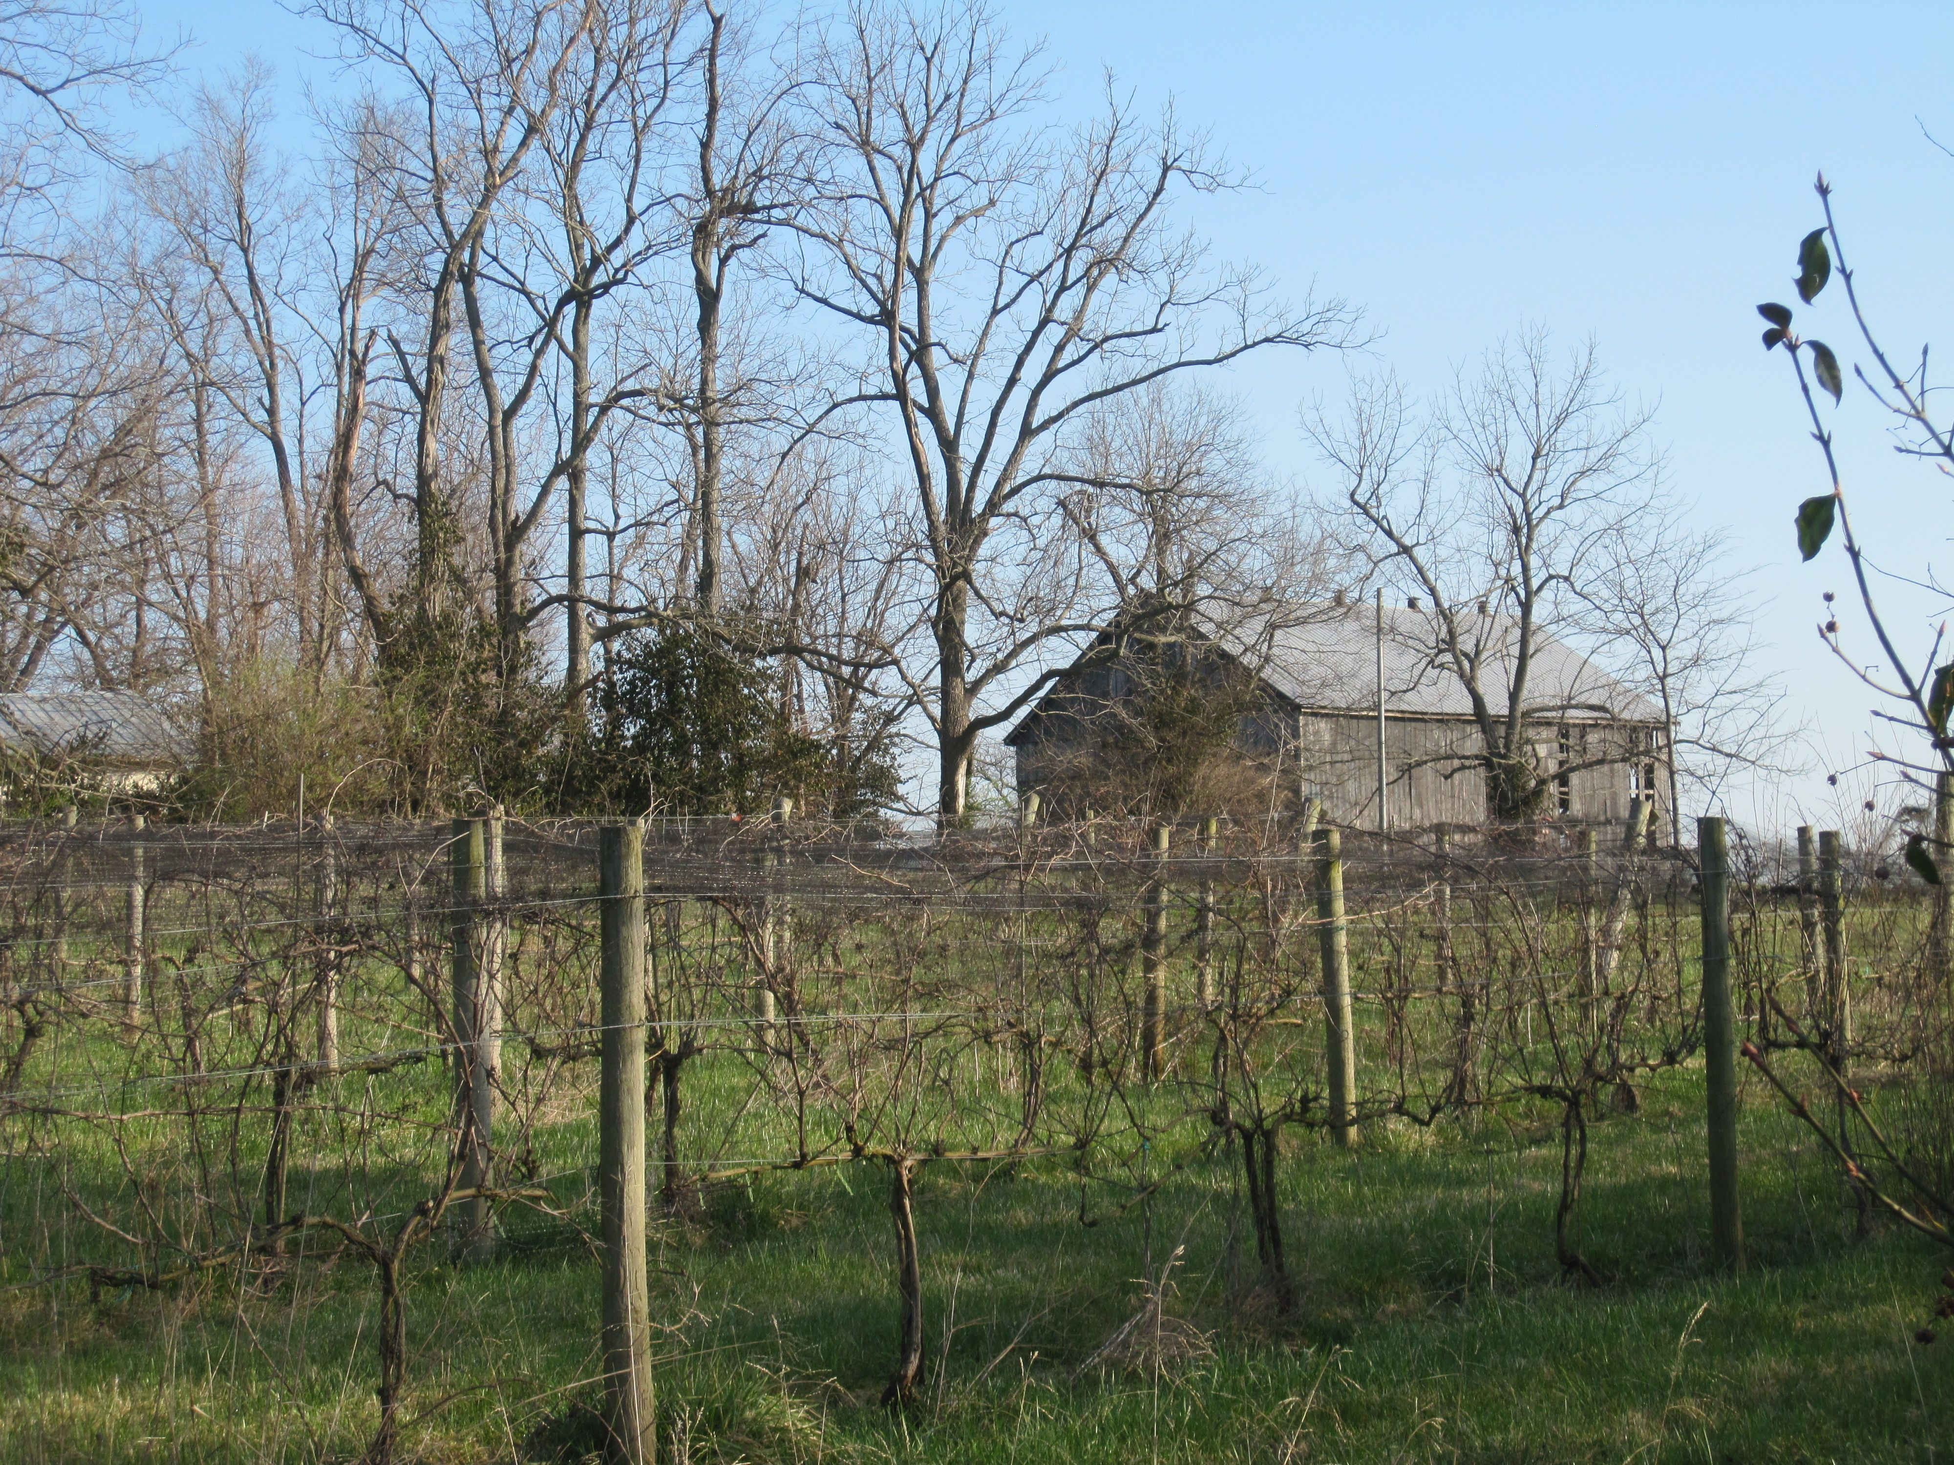
Rurality
as place
Appalachian Mountains
of
Eastern Kentucky
Notes:
Appalachia as unique cultural, linguistic and religious traditions
Economy of self-sufficiency and independence – small farms, hunting, use of local resources
Deeply tied to place in the small valleys and towns of the mountains
Paid employment: timber and coal industries (owned by outsiders); civil service. Men more likely to have FT waged work than women
In past, much of this work did not require formal education credentials. That has changed

Slide 6
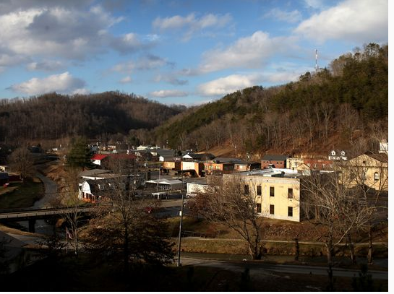
Situated self
Place and space
Gender performativity
Intersectionality
Learning contexts sensible to possibilities, contingencies, realities and constraints
Lives on the economic and social margins

Slide 7
Endangered self
Dangers of having a low education level
As one woman said about participating in a group class: “Then someone knows what I’m doing and what I can’t do.”
Risks:
Stigma (Goffman): Exposure as an adult who can’t read; teacher who works with poor adults
threats of restructured personal relationships
cost in time, labor and transportation to participate
Deskilling
Job insecurity
Notes:
ways in which participating in adult basic education introduces risk and danger into the lives of people who are structurally on the margins of our communities.
Goffman (1963) on stigma: “stigma […] is really a special kind of relationship between attribute and stereotype” (p. 4). These stereotypes and the stigma embedded in these stereotypes are created and managed through our interactions with others.

Slide 8
Imagined self: a literate woman
Return to school to earn a high school equivalency diploma or learn a trade
Decode the danger signs in the chicken processing plant
Complete the job application
Navigate digital worlds
Earn a driver’s license
Assist children with homework and read to grandchildren
Read aloud in adult Bible study circles
Mission to save

Slide 9
“Loretta had a paranoia of computers at the beginning. We would say, ‘Will you be willing to sit for 30 minutes and work the software? And at first, at 29 minutes she was ready to get off. She was ready. But then it was like suddenly 45 minutes, and then it was an hour, and then it was, ‘Oh my goodness, I sat there an hour and 15 minutes. And I look forward to this. I love it. I can’t believe I’m on a computer.”

Slide 10
References
Butler, Judith (1990) Gender Trouble. New York: Routledge.
Foucault, Michel (1979). Discipline and Punish: The birth of the Prison. New York: Vintage Books
Giddens, A. (1984) The Constitution of Society: Outline of a Theory of Structuration. Cambridge: Polity Press.
Goffman, Erving. 1963. Stigma: Notes on the Management of Spoiled Identity. New York: Simon and Schuster.
Goffman, Erving. 1959. Presentation of Self in Everyday Life. New York: Anchor Books.
Hillard, Tom (Summer 2012) Graduating to College. The Working Poor Families Project Policy Brief
Hoffman, Diane (1998) A Therapeutic Moment? Identity, Self, and Culture in the Anthropology of Education Anthropology & Education Quarterly 29 (3): 324-346.
Holland, Dorothy (1998) Identity and Agency in Cultural Worlds , Cambridge, MA: Harvard University Press.
Hunsinger, Jeremy (2005) Broadening Possibilities by Expanding the Theoretical Richness of the Social Construction of Technology. Social Epistemology 19 (2-3): 255-259.
Knowles, Malcolm S., et al (2005). The Adult Learner (Sixth Edition). Butterworth-Heinemann.
McCall, Leslie (2005) The Complexity of Intersectionality. Signs 30 (3); 1771-1800.
Merriam, Sharan B., et al (2006). Learning in Adulthood (Third Edition). Jossey-Bass.
O’Meara, K. (2011) Inside the Panopticon. In J. Smart, et al, eds. Higher Education: Handbook of Theory and Research. 161-209. Spring Science + Business Media b. doi:10.1007/978-94-007-072-3-5
Purcell-Gates, Victoria (1997) Other People's Words: The Cycle of Low Literacy. Cambridge, MA: Harvard University Press.
Quigley, B. Allan (1996) Rethinking Literacy Education: The Critical Need for Practice-Based Change. Jossey Bass.
Quigley, B. A. (2006) Building Professional Pride in Literacy: A Dialogical Guide to Professional Development. Krieger Publishing Company.
Smith, Dorothy E. 1990. The Conceptual Practices of Power: A Feminist Sociology of Knowledge. Boston: Northeastern University Press.
Spindler, George & Louise Spindler(1992) The Enduring, Situated, and Endangered Self in Fieldwork: A Personal Account. In The Psychoanalytic Study of Society, vol. 17. Essays in Honor of George D. and Louise A. Spindler. L. Bryce Boyer and Ruth M. Boyer, eds. 23-28. Hillsdale, NJ: The Analytic Press.

